Slide 1
5-Deep Reinforcement Learning

Slide 2
Overview
What is Reinforcement Learning?
Learning from interaction with an environment to achieve some long-term goal that is related to the state of the environment
The goal is defined by reward signal, which must be maximised
Agent must be able to partially/fully sense the environment state and take actions to influence the environment state
The state is typically described with a feature-vector

Slide 3
Overview of Deep Q Networks
Q-table can handle simple problems with few states
Q Learning builds a Q-table of State-Action values, with dimension (s, a), where s is the number of states and a is the number of actions. Fundamentally, a Q-table maps state and action pairs to a Q-value.

Slide 4
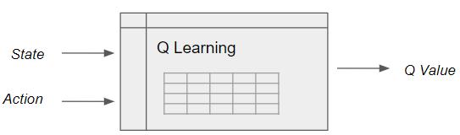

Slide 5
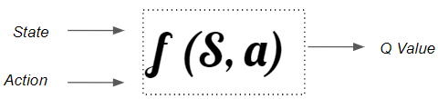
Use a Q-Function for real-world problems
To address this limitation we use a Q-function rather than a Q-table, which achieves the same result of mapping state and action pairs to a Q value.

Slide 6
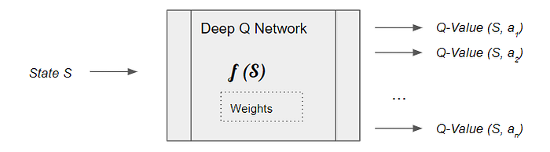
Neural Nets are the best Function Approximators
Since neural networks are excellent at modeling complex functions, we can use a neural network, which we call a Deep Q Network, to estimate this Q function.
This function maps a state to the Q values of all the actions that can be taken from that state.

Slide 7
DQN Architecture Components
The DQN architecture has two neural nets, the Q network and the Target networks, and a component called Experience Replay. The Q network is the agent that is trained to produce the Optimal State-Action value.
Experience Replay interacts with the environment to generate data to train the Q Network.

Slide 8
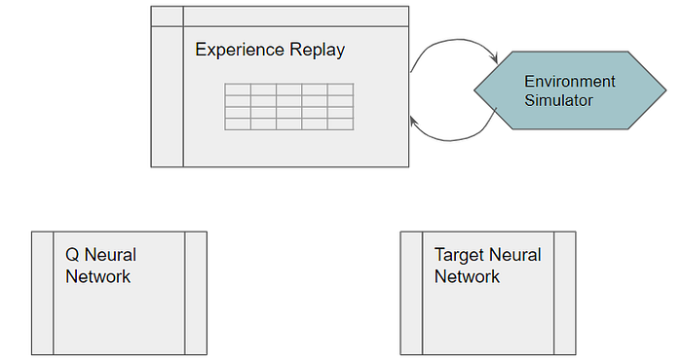

Slide 9
The Q Network is a fairly standard neural network architecture and could be as simple as a linear network with a couple of hidden layers if your state can be represented via a set of numeric variables. Or if your state data is represented as images or text, you might use a regular CNN or RNN architecture.
The Target network is identical to the Q network.

Slide 10
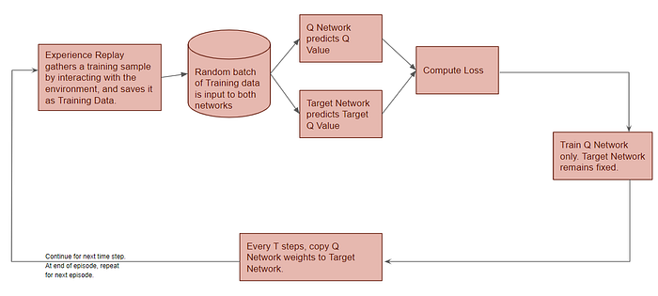
The DQN gets trained over multiple time steps over many episodes. It goes through a sequence of operations in each time step:
These operations are performed in each time-step

Slide 11
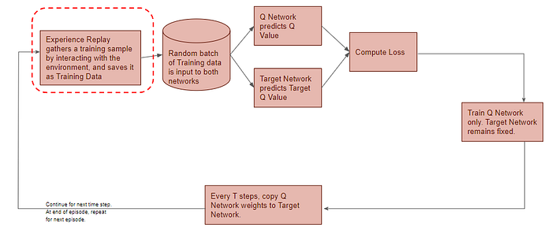
Gather Training Data

Slide 12
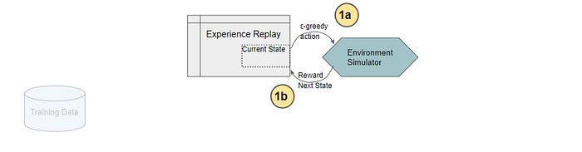
Experience Replay selects an ε-greedy action from the current state, executes it in the environment, and gets back a reward and the next state.

Slide 13
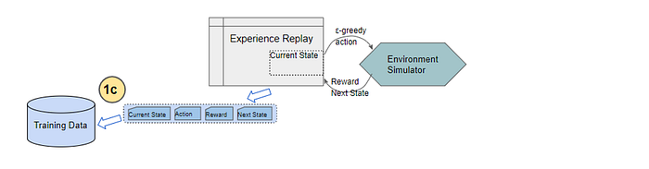
It saves this observation as a sample of training data.

